Slide 1
CreditBalance API

Slide 2
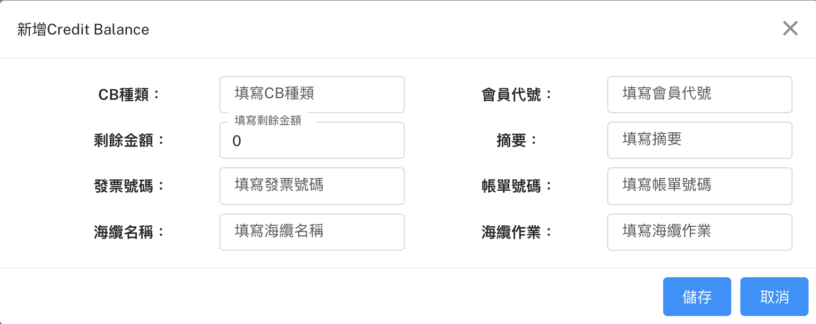
新增CB
Method: POST
URL: http://localhost:8000/api/v1/CreditBalance
POST Body:
{
"WorkTitle": "string",
"InvoiceNo": "string",
"PartyName": "string",
"SubmarineCable": "string",
"CBType": "string",
"BillingNo": "string",
"BillMilestone": "string",
"CurrAmount": float,
"Note": "string"
}
空值就不要放進來

Slide 3
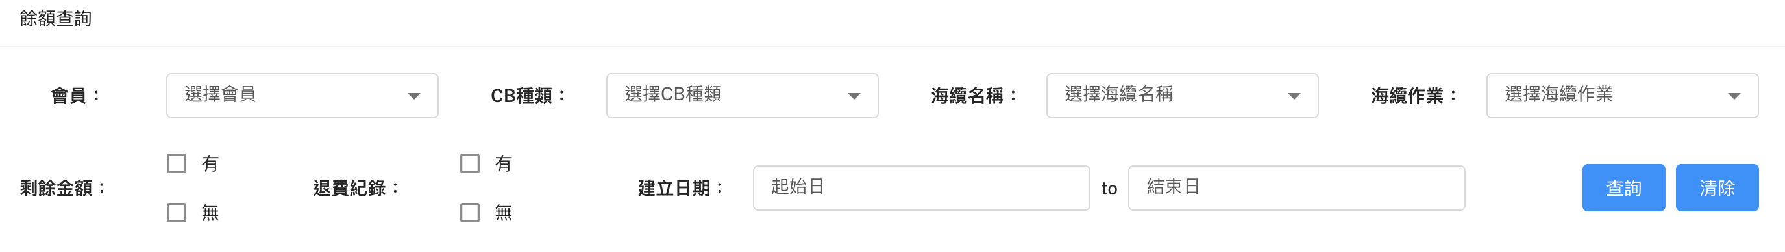
查詢CB
GET http://127.0.0.1:8000/api/v1/SubmarineCables/all
GET http://127.0.0.1:8000/api/v1/Parties/all
Method: POST
URL: http://localhost:8000/api/v1/CreditBalance/{urlCondition}
urlCondition:
1. all
2. PartyName=會員名稱&CBType=CB種類&SubmarineCable=海纜名稱&WorkTitle=海纜作業&startCreateDate=YYYYMMDD&endCreateDate=YYYYMMDD
Response Content:
[
{
"CBID": int / null,
"BLDetailID": int / null,
"WorkTitle": string / null,
"InvoiceNo": string / null,
"PartyName": "CHT",
"LastUpdDate": 2023-03-01T00:00:00 / null,
"SubmarineCable": string / null,
"CBType": string / null,
"BillingNo": string / null,
"BillMilestone": string / null,
"CurrAmount": float,
"CreateDate": "2023-03-01T00:00:00",
"Note": string / null
}
]

Slide 4
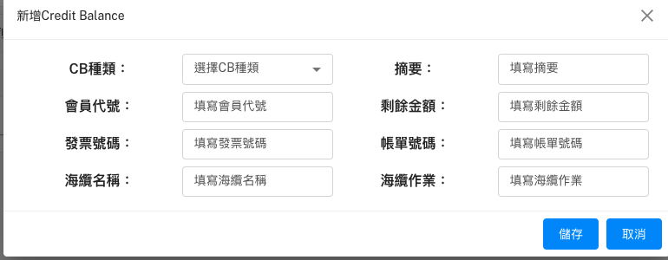
查詢CB
GET http://127.0.0.1:8000/api/v1/Parties/all
GET http://127.0.0.1:8000/api/v1/SubmarineCables/all

